Slide 1

HEART-ATTACK PREDICTION USING MACHINE LEARNING
Batch No: B-04 Project Guide:
N.Monaj (164G1A0561) Mr.C. Sudheer Kumar, M.Tech.
Y.Premalatha (164G1A0570) Assistant Professor`.
V.Yuva sree (164G1A05B9)
B.Yogi vallabh gowd (164G1A05C0)
Githublink:
Srinivasa Ramanujan Institute of Technology
Department of Computer Science & Engineering

Slide 2
Abstract
Now-a-days the impact of chronic diseases has been increased, that results in the greater damage to the people regarding the health and financial issues.
Also a greater challenge to the doctors is to diagnose the patients correctly,False clinical decisions can lead to disastrous consequences .
Cardiovascular diseases are the leading cause of death globally, resulted in 17.9 million deaths (32.1%) in 2015, up from 12.3 million (25.8%) in 1990.
The main objective of this study is to build a model that can predict the heart attack occurrence, based on a combination of features describing the disease.
This project focuses on one of the chronic disease such as Heart Attack. The project diagnosis Heart Attack before consulting a doctor based on the features such as age, blood pressure level, cholesterol level and so on for the prediction.
Different machine learning classification techniques will be implemented and compared upon standard performance metric such as accuracy.
This model makes use of one of the classification technique such as Support Vector classifier to predict the Heart Attack with high accuracy.

Slide 3
Existing System
Existing system was developed using the Naive Bayes Classifier.
In this a huge number of features are involved. So, there is a need to reduce the number of features.
Features reduction can be done by the feature selection.
Feature selection reduces the processing power further time for the prediction of Heart Attack is reduced.
When the model uses the large processing power then that results in the inappropriate accuracy.

Slide 4
Proposed System
The proposed system was developed using the Support Vector Classifier .
Support Vector Classifier uses the minimum number of features.
Features are being reduced by the process of feature selection.
The Support Vector Classifier classifies the data with high accuracy with minimum features only ,further reducing the processing power of the system.

Slide 5
PLANNING
INPUT HEART ATTACK DATA SET
REPLACE MISSING VALUES WITH COLUMN MEANS
MODEL BUILDING
TESTING THE CONSTRUCTED MODELS
Collection of Dataset.
Preprocessing of the dataset.
Dividing the total dataset into Training and Testing dataset.
Selecting the required algorithms.
Modeling the data.
Testing the data.

Slide 6
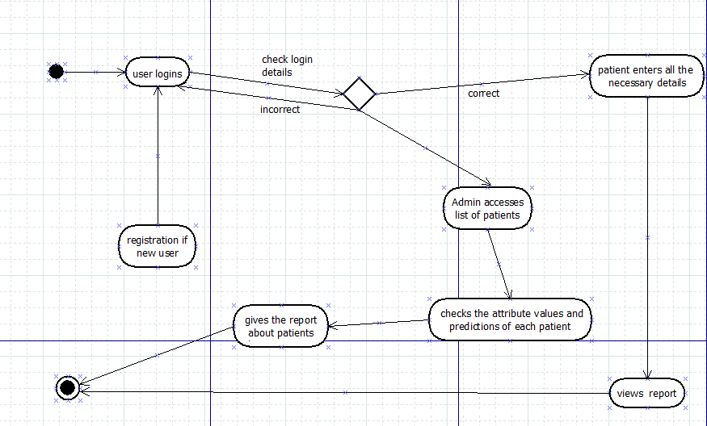
Activity Diagram

Slide 7
Implementation
Modules in Heart attack Prediction are :
User module.
Admin module.
Classification module.

Slide 8
User Module
Data like the patients Name, Mail id, Password and Profile picture are collected from the patients themselves to help with the creation of an individual user account.
Already registered user can directly start accessing the system with the help of the user id and password provided.
Patients enters the necessary details like Age, Gender, Chest pain, Resting BP, serum Cholesterol, Fasting Blood Sugar, Resting Electro cariographic Result(ECG), Maximum Heart Rate, Exercise Induced Angina, Slope of Peak Exercise ST segment, Number of Major Vessels colored by Flourosopy, Thalium Scan Results.

Slide 9
Classification Module
Support Vector Classifier is a Supervised Machine learning algorithm, which works on the labelled data.
Support Vector Classifier divides the data linearly with the help of a Hyper plane.
Hyper plane is a line that sepatates the data points linearly into two classes.
It contains the Margin, which is the space between nearest datapoint of one class to the other class from the hyper plane.
If the data is non linearly separable then it follows the Kernel trick.
According to the Kernel trick the non linear data of low dimension is converted into the data of high dimension.

Slide 10
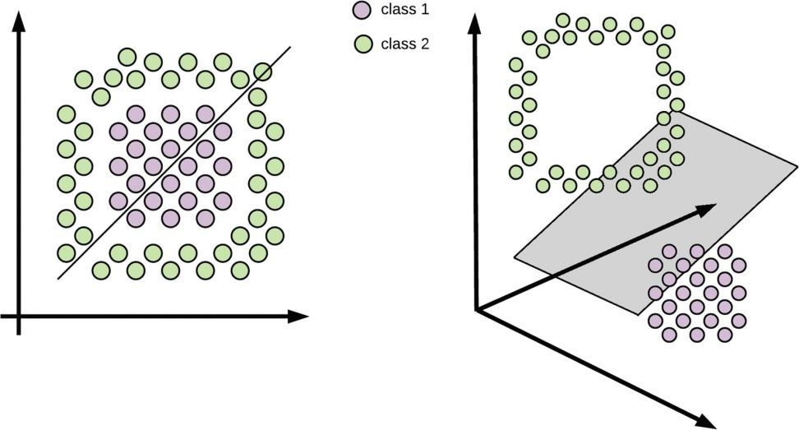
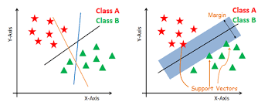
Data Classification
Linear data
Non-Linear data

Slide 11
Admin Module
Admin views all the patients details and their attribute values such as Age, Gender, Chest pain, Resting BP, serum Cholesterol,Fasting Blood Sugar,Resting Electrocariographic Result(ECG),Maximum Heart Rate,Exercise Induced Angina,Slope of Peak Exercise ST segment,Number of Major Vessels colored by Flourosopy,Thalium Scan Results.
The prediction details of each patient also maintained under admin.
The whole data is maintained by the admin and can be analysed based on the need.

Slide 12
Output
Login.
About.
Signup.
Person details.
Predictions.
Profile.
Admin.

Slide 13

Login

Slide 14


About

Slide 15
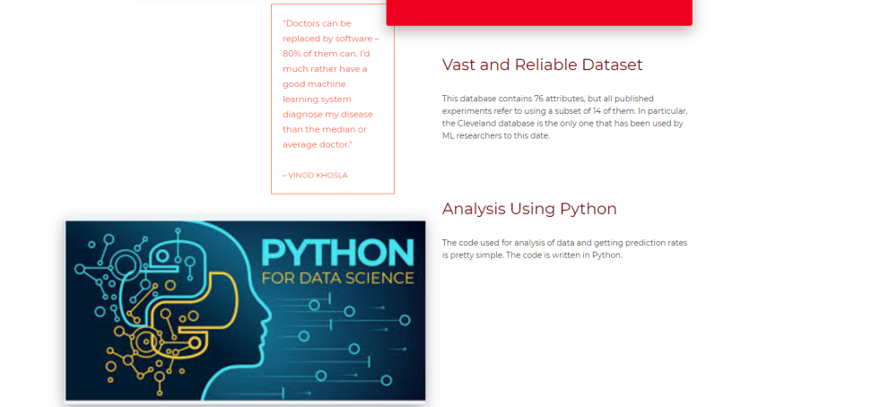

Cont..

Slide 16

Signup

Slide 17

Profile

Slide 18
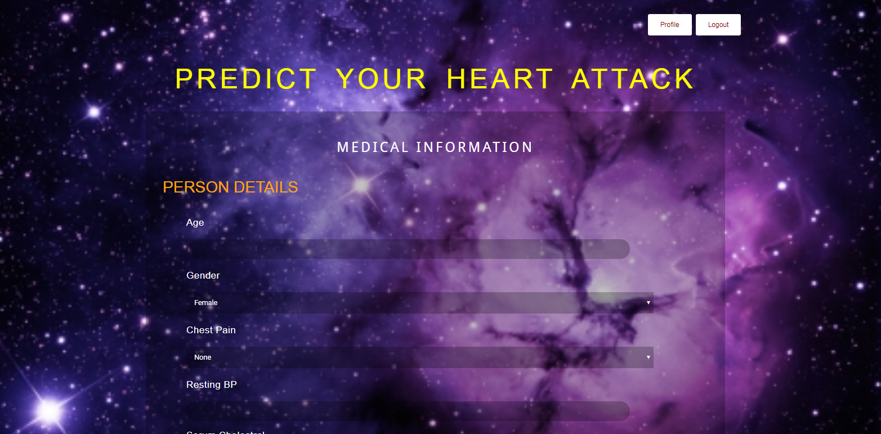
Person Details

Slide 19
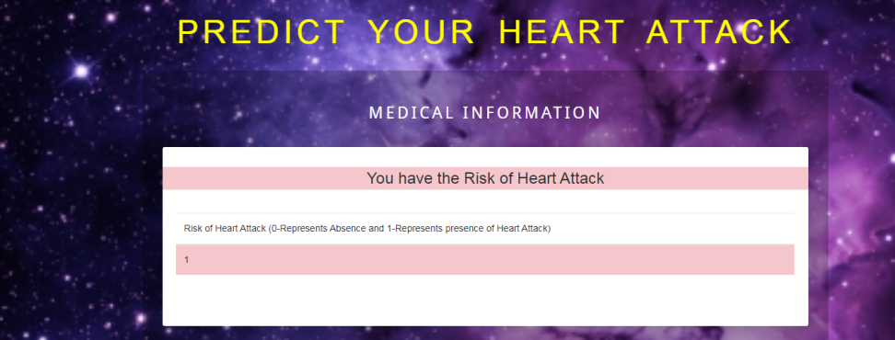
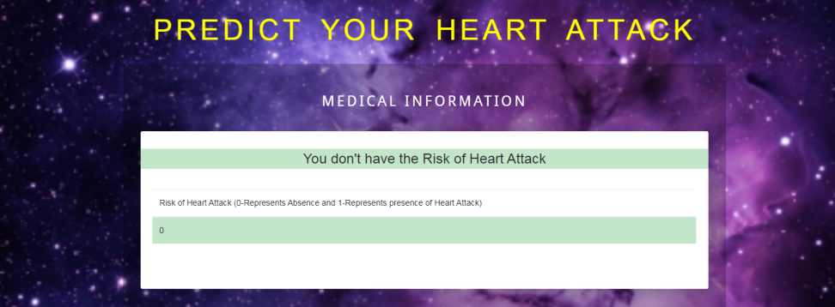
Predictions
Heart Attack
No Heart Attack

Slide 20
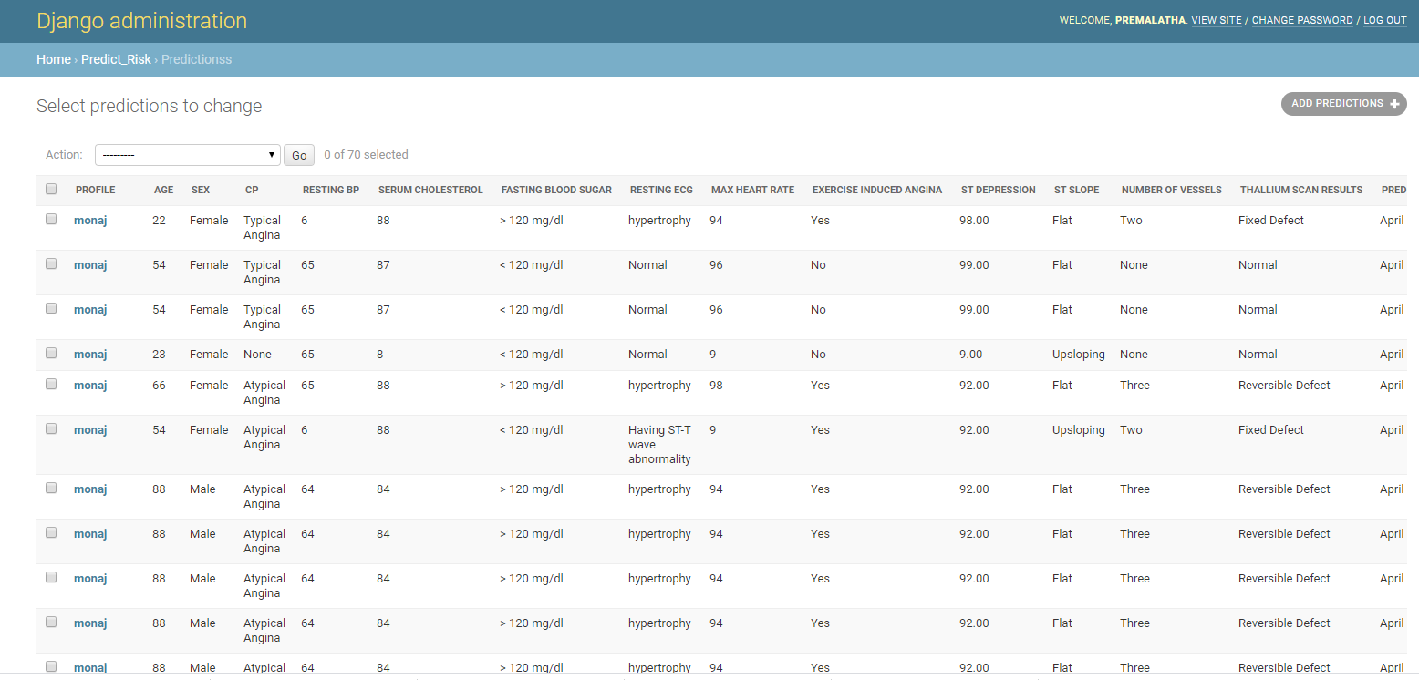
Admin

Slide 21
BIBLIOGRAPHY
Monika Gandhi et.al, [1] used Naïve Bayes, Decision tree and neural network algorithms and analysed the medical dataset. There are a huge number of features involved. So, there is a need to reduce the number of features. This can be done by feature selection. On doing this, they say that time is reduced.
J Thomas, R Theresa Princy [2] made use of K nearest neighbour algorithm, neural network, naïve Bayes and decision tree for heart disease prediction. They made use of data mining techniques to detect the heart disease risk rate.
Benjamin EJ et.al [3] says that there are seven key factors for heart disease such as smoking, physical inactivity, nutrition, obesity, cholesterol, diabetes and high blood pressure. They also discussed the statistics of heart disease including stroke and cardio vascular disease.

Slide 22
REFERENCES
[1] Monika Gandhi, Shailendra Narayanan Singh Predictions in heart disease using techniques of data mining (2015).
[2] Purushottam, Kanak Saxena, Richa Sharma Efficient heart disease prediction system using Decision tree (2015).
[3] Himanshu Sharma,M A Rizvi Prediction of Heart Disease using Machine Learning Algorithms: A Survey (August 2017).

Slide 23
Thank you
Queries
?

